Slide 1
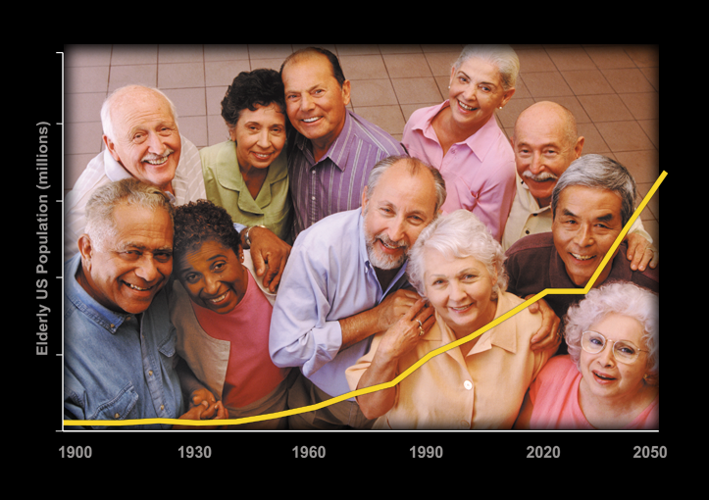
Jeffrey B. Halter, MD
Management of hyperglycemia in older adults with diabetes
2019 International Congress of Diabetes and Metabolism
Seoul, Korea
October 11, 2019

Slide 2
Disclosure
None
Derek LeRoith, Geert Jan Biessels, Susan S Braithwaite, Felipe F Casanueva, Boris Draznin, Jeffrey B Halter, Irl B Hirsch, Marie E McDonnell, Mark E Molitch, M Hassan Murad, Alan J Sinclair, Treatment of Diabetes in Older Adults: An Endocrine Society Clinical Practice Guideline, The Journal of Clinical Endocrinology & Metabolism, Volume 104, Issue 5, May 2019, Pages 1520–1574, https://doi.org/10.1210/jc.2019-00198

Slide 3
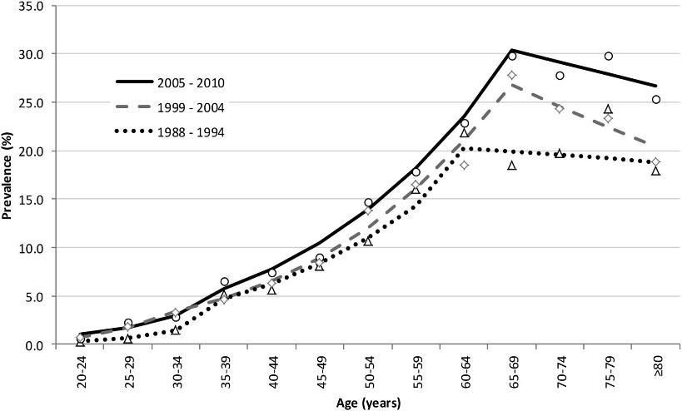

Age-specific unadjusted and sex-, race/ethnicity-, and education-adjusted prevalence of diabetes in adults ≥20 years of age by survey year: U.S. NHANES, 1988–2010.
Cheng Y J et al. Diabetes Care 2013;36:2690-2696
Copyright © 2014 American Diabetes Association, Inc.
Notes:
Age-specific unadjusted and sex-, race/ethnicity-, and education-adjusted prevalence of diabetes in adults ≥20 years of age by survey year: U.S. NHANES, 1988–2010. Each dot of 1988–1994 (△), 1999–2004 (◇), and 2005–2010 (○) represents the unadjusted prevalence within a 5-year age-group. Each line for 1988–1994 (dotted), 1999–2004 (dashed), and 2005–2010 (solid) represents the sex-, race/ethnicity-, and education-adjusted predicted prevalence of the midpoint of the 5-year age-group from piecewise regression, with age as a continuous variable.

Slide 4
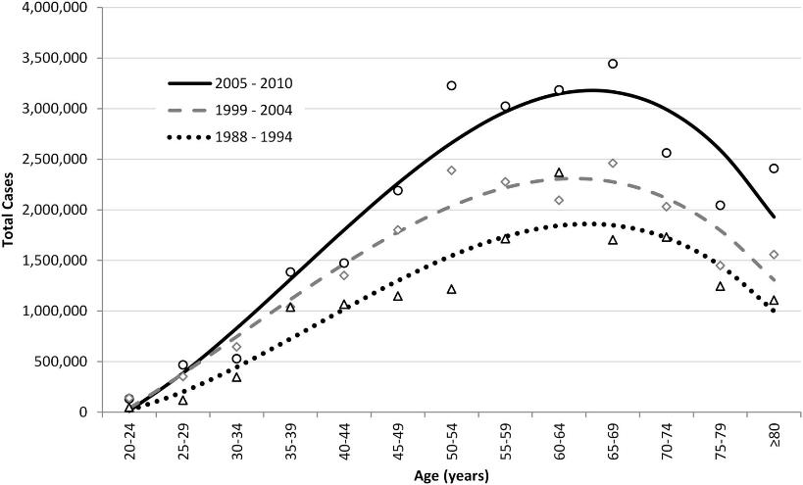
Total number of adults ≥20 years of age with diabetes by survey year:
U.S. NHANES, 1988–2010.
Cheng Y J et al. Diabetes Care 2013;36:2690-2696
Copyright © 2014 American Diabetes Association, Inc.
Notes:
Total number of adults ≥20 years of age with diabetes by survey year: U.S. NHANES, 1988–2010. Each dot of 1988–1994 (△), 1999–2004 (◇), and 2005–2010 (○) represents the total number of adults with diabetes within a 5-year age-group. Each line for 1988–1994 (dotted), 1999–2004 (dashed), and 2005–2010 (solid) represents the smoothed trend line of the total number of adults with diabetes derived from a cubic polynomial regression by age-group (AgeGrp) from 1 (20–24 years) to 13 (≥80 years) for each time period. For 1988–1994, −3,893.6*AgeGrp3 + 52,915*AgeGrp2 + 53,590*AgeGrp – 85,885; for 1999–2004, −3,254.7*AgeGrp3 + 30,451*AgeGrp2 + 274,991*AgeGrp – 263,749; and for 2005–2010, −5,520.1*AgeGrp3 + 68,979*AgeGrp2 + 204,097*AgeGrp – 253,127.

Slide 5
Diabetes in Adults ≥ 65 Years
T2DM major public health problem in older people
2030 ⟹ Prevalence will double
2050 ⟹ Prevalence will increase five-fold
Greatest increase in ≥ 75 years regardless of race; older blacks especially at risk
CDC. National diabetes fact sheet. 2011
CDC. MMWR. Nov. 2012
Notes:
DIABETES IN ADULTS ≥ 65 YEARS
Although increasing numbers of individuals with type 1 diabetes are living into old age, type 2 diabetes is overwhelmingly the most common incident and prevalent type in older age-groups is and is a major public health problem.
The aging of the overall population is a significant driver of the diabetes epidemic and trend data suggest that the burden will continue to increase.
The epidemic of type 2 diabetes is clearly linked to increasing rates of overweight and obesity in the U.S. population, but projections by the Centers for Disease Control and Prevention (CDC) suggest that even if diabetes incidence rates level off, the prevalence of diabetes will double in the next 20 years, in part due to the aging of the population.
By 2050, prevalence is predicted to increase nearly 5 times what it is now unless there are dramatic changes.
The biggest percent increases will be among people aged ≥75 years (336%) and among blacks (275%).
The increase in diabetes among US adults is not news. Behavioral Risk Factor Surveillance System (BRFSS) has been collecting trend data since the mid-1990’s
In 1995, age- adjusted prevalence was ≥6% in only three states.
But by 2010 it was ≥6% in every state; and ≥10.0% in six states.
CDC. National diabetes fact sheet: national estimates and general information on diabetes and prediabetes in the United States. 2011.
CDC. Diabetes data and trends. 2011.

Slide 6
Age and Rates of AMI by Diabetes Status
AMI, acute myocardial infarction
Booth GL, et al. Lancet. 2006;368:29-36.

Slide 7
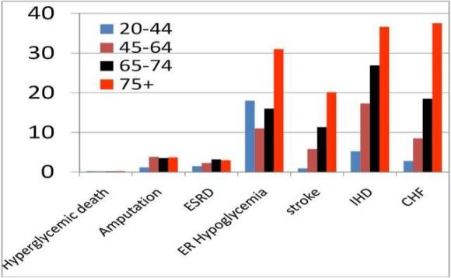
Incidence (per 1,000) of major diabetes complications among adults with diabetes, by age, 2009
Halter JB, et al. Diabetes. 2014;63:2578-2589. Copyright © 2014 American Diabetes Association, Inc.
Notes:
Incidence (per 1,000) of major diabetes complications among adults with diabetes, by age, 2009. Source: National Diabetes Surveillance System, available from http://www.cdc.gov/diabetes. CHF, congestive heart failure; ER, emergency room; ESRD, end-stage renal disease; IHD, ischemic heart disease.

Slide 8

Keep a positive attitude toward aging

Slide 9
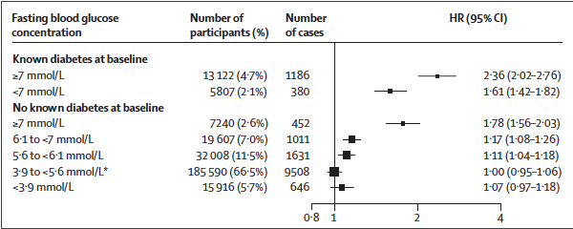
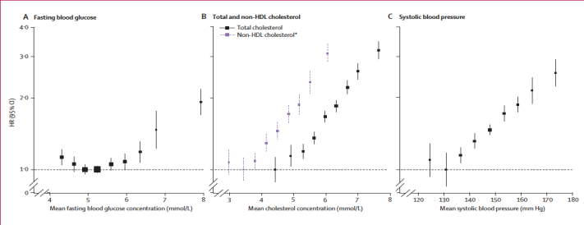
FBG and Risk of CHD
ERFC. Lancet 2010;375:2215-22

Slide 10
Prevention of Diabetes Morbidity
Reduce Vascular Disease Risk Factors
Hyperglycemia
Hypertension
Dyslipidemia
Cigarette use
Lack of exercise
Obesity

Slide 11

Heterogeneity of Older People with Diabetes
RELATIVELY HEALTHY
DIFFICULT TO IMPLEMENT
LIMITED BENEFIT
  < 3 chronic diseases
  No cognitive or significant visual impairment
  0 or 1 instrumental activities of daily living (IADL) dependencies
  ≥ 3 chronic diseases
  Mild cognitive impairment
  Severe vision impairment
  ≥ 2 IADL dependencies
  End-stage illness
  Moderate to severe cognitive impairment
  ≥ 2 ADL dependencies
  Residence in a long-term nursing facility
Blaum CS, et al. Medical Care. 2010;48:327-334.
Notes:
EFFECTS OF HEALTH STATUS
Some elderly patients with diabetes have health status characteristics that can make diabetes self-management difficult and lead to inadequate glycemic control, or limit the benefit of some diabetes management interventions.
Blaum, et al. conducted an analysis on data collected in the Health and Retirement Study to determine how many middle-aged and older adults with diabetes in the United States would have complex health status potentially associated with DSM difficulty or limited benefit of some diabetes management.
They defined 3 health status groups based on the literature and clinical experience
Relatively Healthy Group - fewer than 3 chronic diseases, no cognitive or significant visual impairment, and one or no instrumental activities of daily living (IADL) dependencies (which they later subdivided into an Extremely Healthy Group)
Difficult to Implement - had health characteristics that could make DSM difficult, whose members have one or more of the following characteristics: 3 or more chronic diseases (in addition to diabetes), mild cognitive impairment, severe vision impairment, and/or 2 or more IADL dependencies.
Limited Benefit Group – included people with the poorest health status, with one or more of the following: moderate to severe cognitive impairment, 2 or more ADL dependencies, and/or residence in a long-term nursing facility.
Blaum, Caroline S., et al. Clinical complexity in middle-aged and older adults with diabetes: the Health and Retirement Study. Medical care. 2010; 48(4):327-334.

Slide 12
Heterogeneity in health status among patients with diabetes
Blaum CS, et al. Medical Care. 2010;48:327-334.

Slide 13
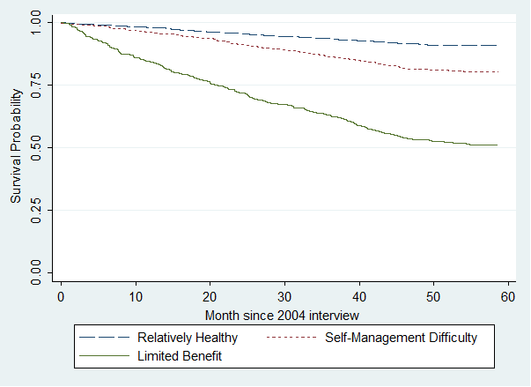
The survival probabilities at five years were:
Relatively Healthy Group, 90.8%; Self-Management Difficulty Group, 79.4%; and Limited Benefit Group, 52.5%.
Notes:
1. Relatively Healthy Group. Characterized by:
--Two or fewer comorbid chronic diseases,
--No vision impairment,
--No cognitive impairment,
--Dependency in no more than one instrumental activity of daily living (IADL),
--Dependency in no more than one activity of daily living (ADL), AND
--Not living in a long-stay nursing facility.
2. Self-Management Difficulty Group. Characterized by:
--Three or more comorbid chronic diseases,
--Severe vision impairment,
--Mild cognitive impairment, OR
--Dependency in two or more IADLs.
3. Limited Benefit Group. Characterized by:
--Dementia,
--Dependency in two or more ADLs, OR
--Living in a long-stay nursing facility.

Slide 14
3.1 In patients aged 65 years and older with diabetes, we advise assessing the patient’s overall health (see Table 2) and personal values prior to the determination of treatment goals and strategies (see Table 3). (Ungraded Good Practice Statement)
www.medicareinteractive.org/get-answers/medicare-covered-services/preventive-services/annual-wellness-visit
Derek LeRoith, Geert Jan Biessels, Susan S Braithwaite, Felipe F Casanueva, Boris Draznin, Jeffrey B Halter, Irl B Hirsch, Marie E McDonnell,
Mark E Molitch, M Hassan Murad, Alan J Sinclair, Treatment of Diabetes in Older Adults: An Endocrine Society Clinical Practice Guideline,
The Journal of Clinical Endocrinology & Metabolism, Volume 104, Issue 5, May 2019, Pages 1520–1574, https://doi.org/10.1210/jc.2019-00198

Slide 15
What is the approach to determining the appropriate glycemic targets for older adults with T2D?
4.1 In patients aged 65 years and older with diabetes, we recommend that outpatient diabetes regimens be designed specifically to minimize hypoglycaemia.
Technical remark: Although evidence for specific targets is lacking, glycemic targets should be tailored to overall health and management strategies (e.g., whether a medication that can cause hypoglycemia is used) (see Table 3).
Derek LeRoith, Geert Jan Biessels, Susan S Braithwaite, Felipe F Casanueva, Boris Draznin, Jeffrey B Halter, Irl B Hirsch, Marie E McDonnell,
Mark E Molitch, M Hassan Murad, Alan J Sinclair, Treatment of Diabetes in Older Adults: An Endocrine Society Clinical Practice Guideline,
The Journal of Clinical Endocrinology & Metabolism, Volume 104, Issue 5, May 2019, Pages 1520–1574, https://doi.org/10.1210/jc.2019-00198

Slide 16
Derek LeRoith, Geert Jan Biessels, Susan S Braithwaite, Felipe F Casanueva, Boris Draznin, Jeffrey B Halter, Irl B Hirsch, Marie E McDonnell, Mark E Molitch, M Hassan Murad,
Alan J Sinclair, Treatment of Diabetes in Older Adults: An Endocrine Society Clinical Practice Guideline, The Journal of Clinical Endocrinology & Metabolism, Volume 104, Issue 5,
May 2019, Pages 1520–1574, https://doi.org/10.1210/jc.2019-00198

Slide 17

Staying as independent as possible is often critical to quality of life

Slide 18
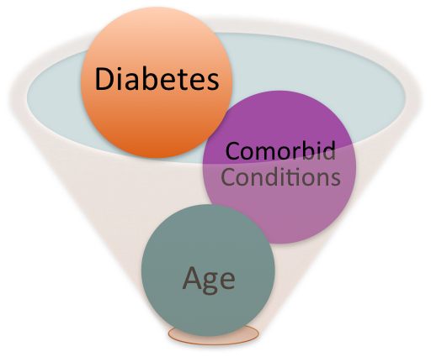
Polypharmacy
Common Comorbidities Requiring Daily Multiple-drug Regimens | Common Comorbidities Requiring Occasional Multiple-drug Regimens
Hypertension | Glaucoma
Dyslipidemia | Peripheral Vascular Disease
Coronary artery disease | Lower-extremity Ulcers
Renal disease | Obesity
Congestive heart failure | Glucose Lowering Medications
Neuropathy | 11 classes of non-insulin drugs 3 rapid-acting insulin analogs 3 long-acting analogs Traditional insulins
Cognitive Dysfunction
Depression
Notes:
POLYPHARMACY
Multiple drug therapy has become the standard of care for treating most chronic conditions, which brings with it complications of adverse reactions and contrary interactions.
This is especially true in the case of elderly patients, who are particularly susceptible to adverse drug events.
Although not specifically studied, it is likely that diabetic elderly patients are even more susceptible to problems related to polypharmacy because of significantly greater underlying physical disability.
One of the challenges in treating type 2 diabetesin the elderly is that polypharmacy is usually intentional and necessary to control related comorbidities and reduce the risk of diabetes complications
Several factors contribute to polypharmacy in diabetic patents.
The comorbidities of diabetes commonly include conditions that require daily medication, such as hypertension, dyslipidemia, neuropathy, depression; and others that require occasional medication, such as glaucoma and peripheral vascular disease-- each of which may require one or more drugs for adequate control.
Add to this other conditions that often accompany diabetes, such as hypothyroidism, heart failure, and osteoporosis, and the total number of possible medications needed becomes significant.
Polypharmacy is inevitable when treating a common chronic condition such as diabetes, given the large number of treatment options now available. The potential for polypharmacy will continue to increase with time, as additional therapeutic options become available. Before the approval of metformin in the United States in 1995, only insulin and the sulfonylureas were available for the treatment of diabetes. Now, there are five classes of oral agents, three rapid-acting insulin analogs, and two long-acting analogs, as well as the “traditional” insulins. The emergence of other forms of insulin (inhaled, topical patches), the incretin gut hormones, newer mixed peroxisome proliferator–activated receptor-α and -γ agonists, a synthetic amylin analog, and still more agents to come will increase opportunities for success in treatment, as well as the potential for polypharmacy.
REVIEWER – IS THE LIST OF TYPES OF DIABETES MEDCIATIONS CURRENT AND CORRECT?

Slide 19
Jeffrey B. Halter, MD
Management of hyperglycemia in older adults with diabetes
2019 International Congress of Diabetes and Metabolism
Seoul, Korea
October 11, 2019

Slide 20
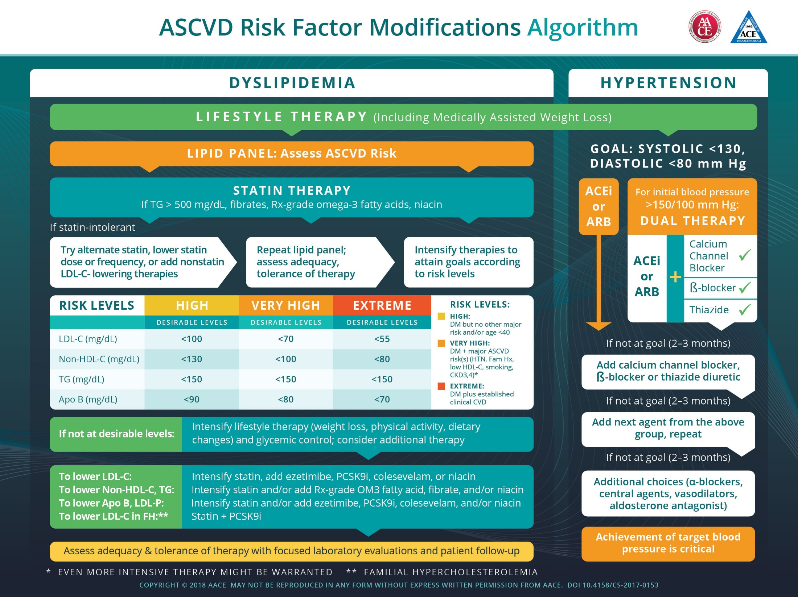

Slide 21
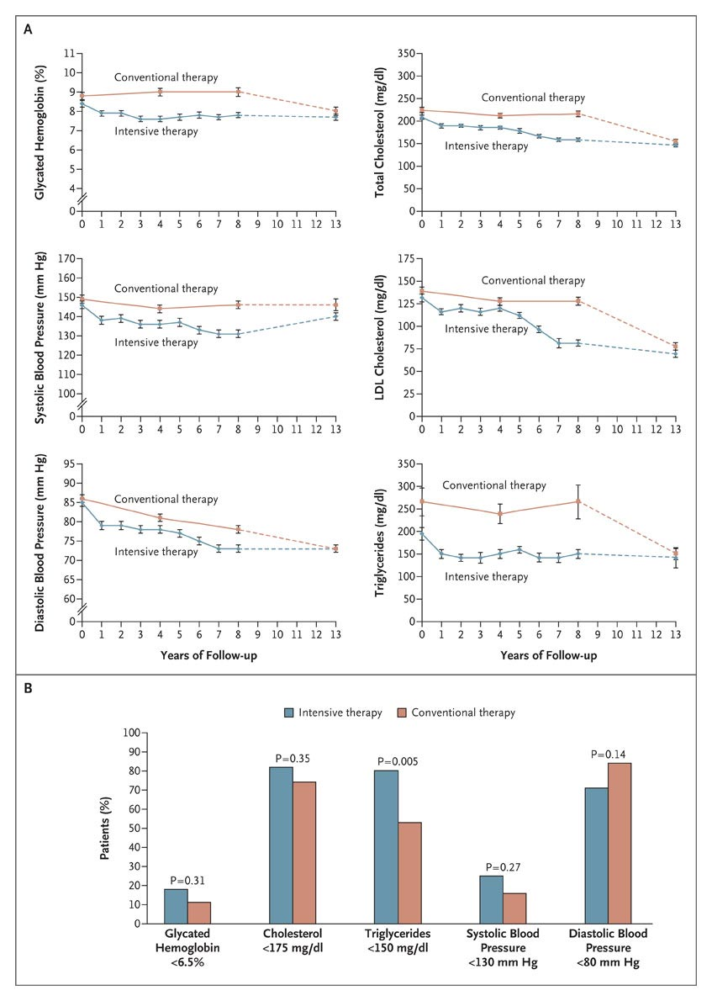
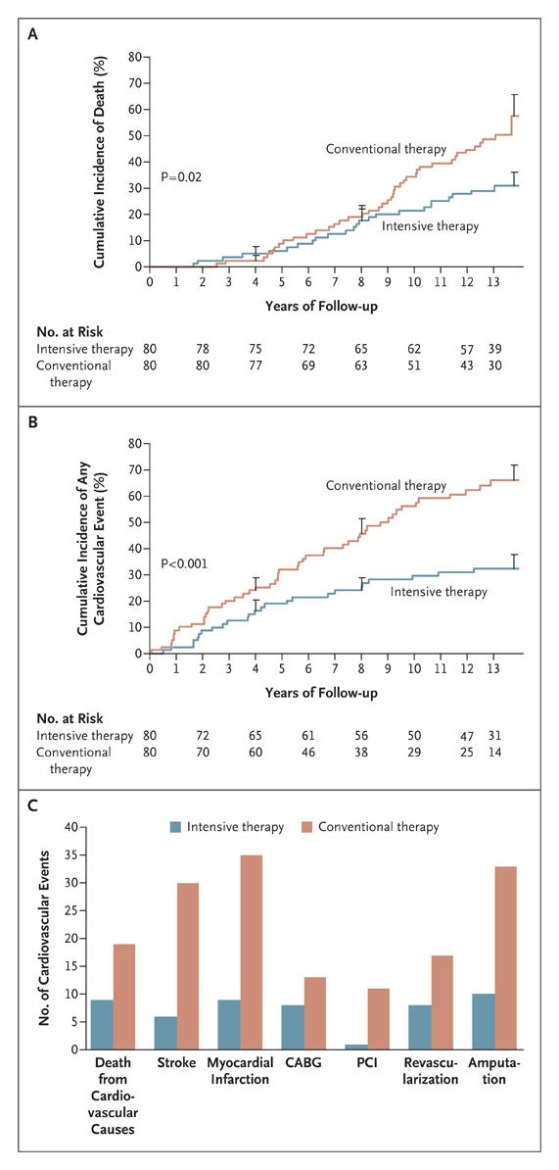

Risk of Death from Any Cause and from Cardiovascular Causes and the Number of Cardiovascular Events, According to Treatment Group
Gaede P et al. N Engl J Med 2008;358:580-591
Notes:
Figure 3. Kaplan-Meier Estimates of the Risk of Death from Any Cause and from Cardiovascular Causes and the Number of Cardiovascular Events, According to Treatment Group. Panel A shows the cumulative incidence of the risk of death from any cause (the study's primary end point) during the 13.3-year study period. Panel B shows the cumulative incidence of a secondary composite end point of cardiovascular events, including death from cardiovascular causes, nonfatal stroke, nonfatal myocardial infarction, coronary-artery bypass grafting (CABG), percutaneous coronary intervention (PCI), revascularization for peripheral atherosclerotic artery disease, and amputation; Panel C shows the number of events for each component of the composite end point. In Panels A and B, the I bars represent standard errors.

Slide 22
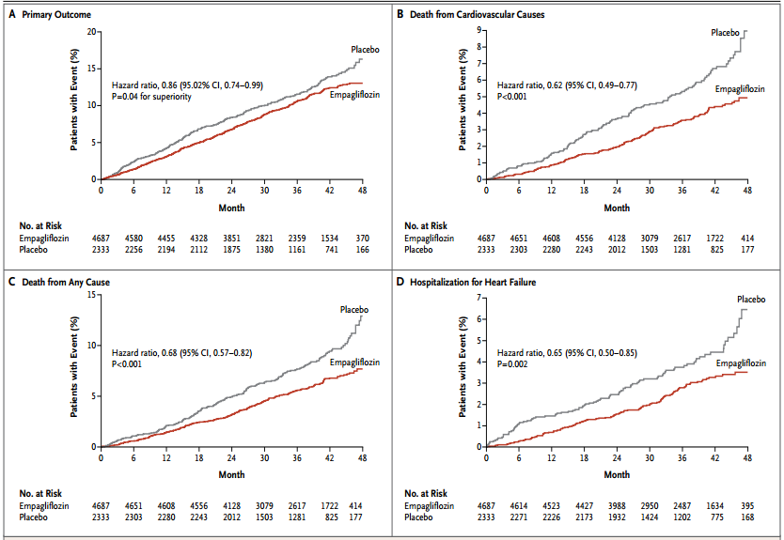
Cardiovascular Outcomes and Death from Any Cause
Zinman B et al. N Engl J Med. 2015;373:2117-2128.
Notes:
Figure 1. Cardiovascular Outcomes and Death from Any Cause. Shown are the cumulative incidence of the primary outcome (death from cardiovascular causes, nonfatal myocardial infarction, or nonfatal stroke) (Panel A), cumulative incidence of death from cardiovascular causes (Panel B), the Kaplan–Meier estimate for death from any cause (Panel C), and the cumulative incidence of hospitalization for heart failure (Panel D) in the pooled empagliflozin group and the placebo group among patients who received at least one dose of a study drug. Hazard ratios are based on Cox regression analyses.

Slide 23
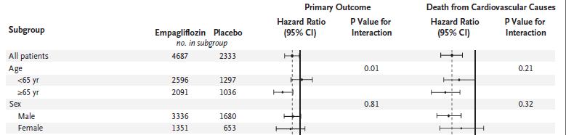
Cardiovascular Outcomes and Death from Any Cause (cont’d)
Zinman B et al. N Engl J Med. 2015;373:2117-2128.
Notes:
Figure 1. Cardiovascular Outcomes and Death from Any Cause. Shown are the cumulative incidence of the primary outcome (death from cardiovascular causes, nonfatal myocardial infarction, or nonfatal stroke) (Panel A), cumulative incidence of death from cardiovascular causes (Panel B), the Kaplan–Meier estimate for death from any cause (Panel C), and the cumulative incidence of hospitalization for heart failure (Panel D) in the pooled empagliflozin group and the placebo group among patients who received at least one dose of a study drug. Hazard ratios are based on Cox regression analyses.

Slide 24
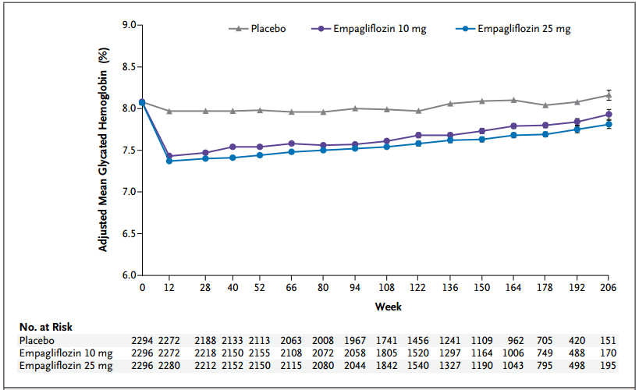
Glycated Hemoglobin Levels
Zinman B et al. N Engl J Med. 2015;373:2117-2128.
Notes:
Figure 3. Glycated Hemoglobin Levels. Shown are mean (±SE) glycated hemoglobin levels in the three study groups, as calculated with the use of a repeated-measures analysis as a mixed model of all data for patients who received at least one dose of a study drug and had a baseline measurement. The model included baseline glycated hemoglobin as a linear covariate, with baseline estimated glomerular filtration rate, geographic region, body-mass index, the last week a patient could have had a glycated hemoglobin measurement, study group, visit, visit according to treatment interaction, and baseline glycated hemoglobin according to visit interaction as fixed effects.

Slide 25
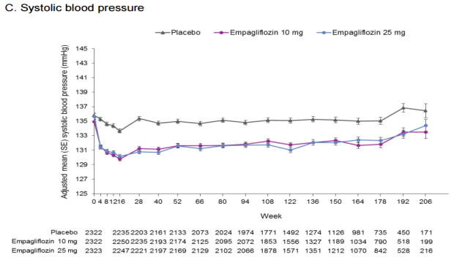
Systolic Blood Pressure
Zinman B et al. N Engl J Med. 2015;373:2117-2128.

Slide 27
Management of Hypertension in Older Adults with Diabetes: Recommendations
In patients aged 65 to 85 years with diabetes, we recommend a target blood pressure of 140/90mm Hg to decrease the risk of cardiovascular disease outcomes, stroke, and progressive chronic kidney disease.
Technical remark: Patients in certain high-risk groups could be considered for lower blood
pressure targets (130/80 mm Hg), such as those with previous stroke or progressing chronic kidney disease (estimated glomerular filtration rate <60 mL/min/1.73 m2 and/or albuminuria).
2. In patients aged 65 years and older with diabetes and hypertension, we recommend that an angiotensin converting enzyme inhibitor or an angiotensin receptor blocker should be the first-line therapy.
Technical remark: If one class is not tolerated, the other should be substituted.
Derek LeRoith, Geert Jan Biessels, Susan S Braithwaite, Felipe F Casanueva, Boris Draznin, Jeffrey B Halter, Irl B Hirsch,
Marie E McDonnell, Mark E Molitch, M Hassan Murad, Alan J Sinclair, Treatment of Diabetes in Older Adults:
An Endocrine Society Clinical Practice Guideline, The Journal of Clinical Endocrinology & Metabolism,
Volume 104, Issue 5, May 2019, Pages 1520–1574, https://doi.org/10.1210/jc.2019-00198

Slide 28
Also See
de Boer IH, et al. Diabetes and hypertension: a position statement by the American Diabetes Association. Diabetes Care. 2017;40(9):1273–1284.
Whelton PK, et al. 2017 ACC/AHA/AAPA/ABC/ACPM/AGS/APHA/ASH/ASPC/NMA/PCNA guideline for the prevention, detection, evaluation, and management of high blood pressure in adults: a report of the American College of Cardiology/American Heart Association Task Force on Clinical Practice Guidelines. Hypertension. 2018;71(6): 1269–1324.
Wright JT Jr, et al. SPRINT Research Group. A randomized trial of intensive versus standard blood pressure control. N Engl J Med. 2015;373(22):2103–2116.
Williamson JD, et al. SPRINT Research Group. Intensive vs Standard Blood Pressure Control and Cardiovascular Disease Outcomes in Adults Aged ≥75 Years: A Randomized Clinical Trial. JAMA.2016;315(24):2673–2682. doi:10.1001/jama.2016.7050

Slide 29
Treatment of Diabetes in Older Adults:
An Endocrine Society Clinical Practice Guideline
Management of Hyperlipidemia in Older Adults with Diabetes
Recommendations
1. In patients aged 65 years and older with diabetes, we recommend an annual lipid profile.
2. In patients aged 65 years and older with diabetes, we recommend statin therapy and the use of an
annual lipid profile to achieve the recommended levels for reducing absolute cardiovascular disease
events and all-cause mortality.
3. In patients aged 65 years and older with diabetes, we suggest that if statin therapy is inadequate for
reaching the low-density lipoprotein cholesterol reduction goal, either because of side effects or
because the low-density lipoprotein cholesterol target is elusive, then alternative or additional
approaches (such as including ezetimibe or Proprotein Convertase Subtilisin/Kexin type 9 inhibitors)
should be initiated.
4. In patients aged 65 years and older with diabetes and fasting triglycerides >500 mg/dL, we recommend the use of fish oil and/or fenofibrate to reduce the risk of pancreatitis.
Note: All items agree in principle with the AACE Lipid Disorders CP Guidelines.
Derek LeRoith, Geert Jan Biessels, Susan S Braithwaite, Felipe F Casanueva, Boris Draznin, Jeffrey B Halter, Irl B Hirsch, Marie E McDonnell, Mark E Molitch, M Hassan Murad, Alan J Sinclair, Treatment of Diabetes in Older Adults: An Endocrine Society Clinical Practice Guideline, The Journal of Clinical Endocrinology & Metabolism, Volume 104, Issue 5, May 2019, Pages 1520–1574, https://doi.org/10.1210/jc.2019-00198

Slide 30
Is it important to screen older adults with T2D for frailty?
No Endo Society Recommendation to screen for frailty
How should non-geriatricians screen for frailty in the outpatient setting?
Derek LeRoith, Geert Jan Biessels, Susan S Braithwaite, Felipe F Casanueva, Boris Draznin, Jeffrey B Halter, Irl B Hirsch, Marie E McDonnell,
Mark E Molitch, M Hassan Murad, Alan J Sinclair, Treatment of Diabetes in Older Adults: An Endocrine Society Clinical Practice Guideline,
The Journal of Clinical Endocrinology & Metabolism, Volume 104, Issue 5, May 2019, Pages 1520–1574, https://doi.org/10.1210/jc.2019-00198

Slide 31
Perkovic et al, NEJM 2019 DOI: 10.1056/NEJMoa1811744

